Slide 1
Can We All Speak The Same Language?
How to ensure data exchange integrity
Cesare Caoduro
Automation & Integration Director - Global @CesareCaoduro

Slide 2
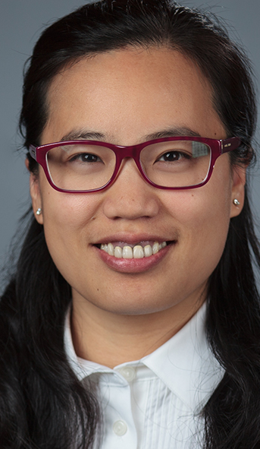
Peggy
Design Automation Lead within Enterprise Capabilities
20+ years of working experience on infrastructural Projects including highway, rail, motorway and process plant
Currently working on delivering design automation workflow, and implementing computational design methodology on projects
Have experience in developing custom solution on desktop and web technologies with C#, Python, Dynamo and grasshopper

Slide 3

Cesare
Automation & Integration Director within Enterprise Capabilities.
Almost 20 years spent in the construction and consultant industry, looking after major project around the globe.
Moved 5 years ago to Australia with AECOM to work on some of the most challenging infrastructure projects, delivering automation, and implementing computational design.
I have an extensive experience developing custom solution using both desktop, web technologies, microservices, and devops implementation.
I love to say that “I work with a bunch of nerd and educated unicorns, half engineers and half developers to shape the way build the future”

Slide 4
Call me Ces!
I am getting older
I know stuffs
I work for a decent sized company

Slide 5
CES501580
SD502756 Don't Look Back: Building a Digital-First Mindset, One Team at a Time
Thursday 1:30pm
Session Description
Learning Objectives
This class is all about defining a common way to exchange data between different authoring tools. In the era of big data and with the increased complexity of projects, how can we ensure that the transfer of design data is consistent and with no data loss?
There are way many attempts to come up with a common strategy for the industry, the reality is that usually none of them is what we are looking for.
Let’s have a look together at what is already available (Speckle, BHoM, etc.), maybe is already what you need, and come up with some semantic strategy to define the language that works for your company (or that has worked for AECOM).
We will finish up with some best practice on how then create add-ins, Dynamo custom nodes, and repositories to support the data exchange and how to use the power of Autodesk Design Automation to create data driven models in a click!
Learn the value of speaking the same design language
Leverage what the market already offers and learn how to extend it
Learn best practice in creating a new language that suites your company
Learn how to develop custom tools to support your data exchange

Slide 6

What to expect today…
and what not.
This is not a lab class, we won’t go into details on all the topics that we are going to cover
Some of the topic can be very technical, others will be more easy to digest
Some comments I will make, may be not exactly in line with your vision. Happy to discuss it after the presentation

Slide 7
Language

Slide 8


What language means for you
LINK
LINK
Stick in there a few words!

Slide 9
Definition of language
What are some of the definitions
language
/ˈlaŋɡwɪdʒ/
A language is a structured system of Communication. The structure of a language is its Grammar and the free components are its Vocabulary. Languages are the primary means of communication of humans, and can be conveyed through speech (spoken language), sign, or writing.

Slide 10



Definition of language
language
/ˈlaŋɡwɪdʒ/
What are some of the definitions
The act of transferring information from one place, person or group to another
Communication
The whole system and structure of a language consisting of syntax, and semantics.
Grammar
Serves as a useful and fundamental tool for communication
Vocabulary

Slide 11
How

Slide 12


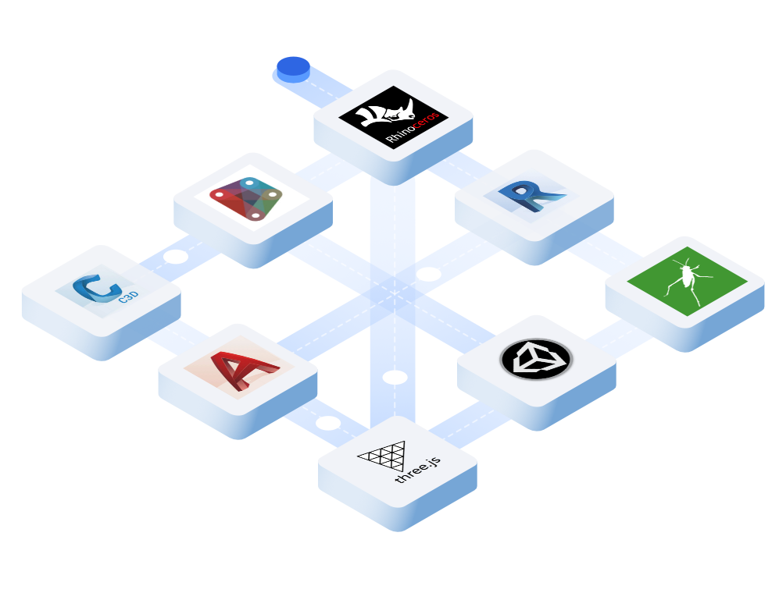
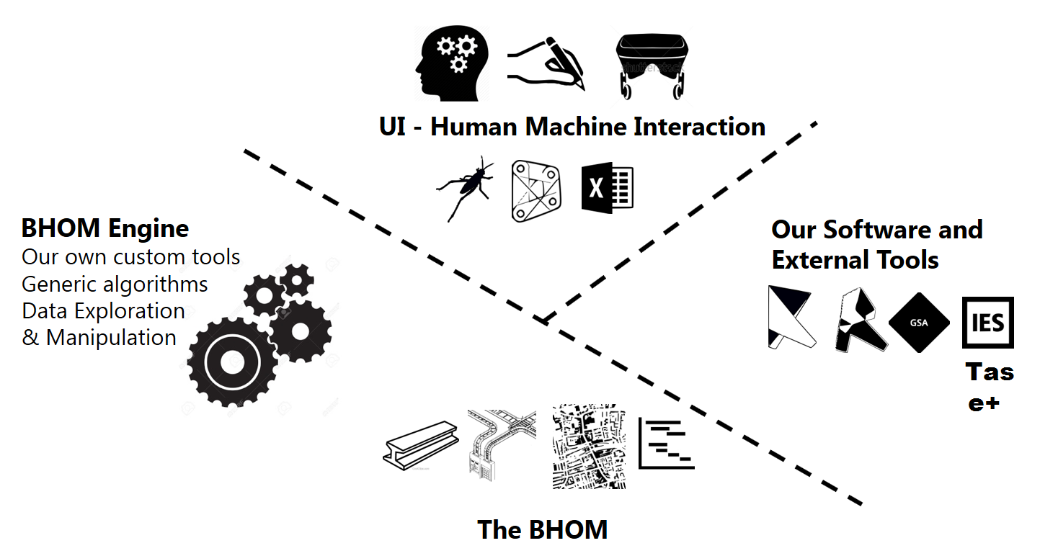
Existing Solutions

Slide 13
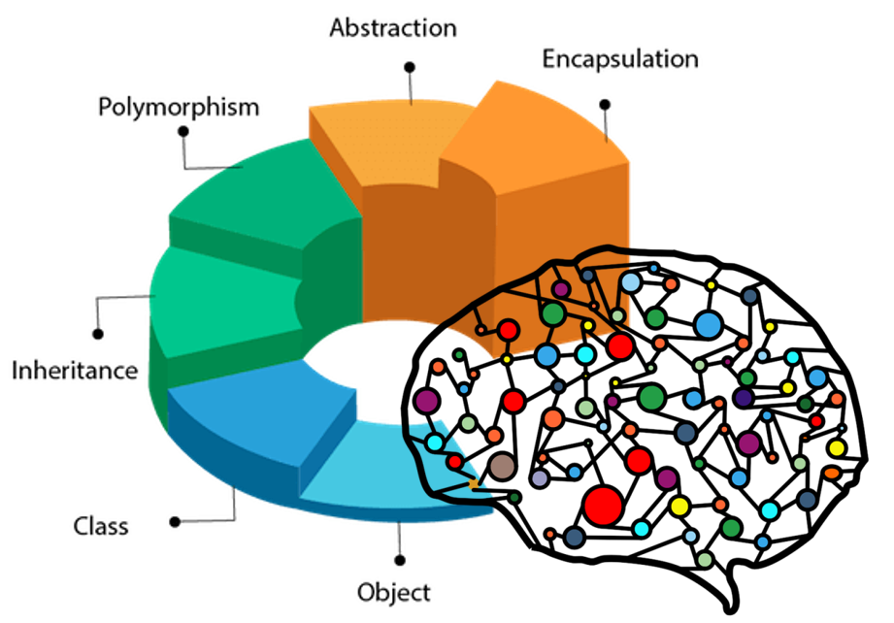
Existing Solutions
Some of the features provided
Object-based
Benefit from a community created object model
Using a common interface, the same objects can be dynamically pushed and pulled across multiple software
Version control (only Speckle)
Collaboration: share your designs collaborate with others
3D Viewer (only speckle through the web portal)
Real time: get real time updates and notifications and changes
GraphQL API (only Speckle)
Webhooks (only Speckle)
Built for developers

Slide 14
Why not?

Slide 15
Some of the reasons
No control over the development directions of the products
No control over the release lifecycle
Not enough granularity in the existing schemas, and complexity in extending them
Generally good import/export behaviours within the same platform, not between platforms
Low fidelity geometry exchange, in particular in the transportation market
Very building centric, not enough maturity in the transportation market
No real competitive advantage in developing third party solutions (IP)

Slide 16




Key requirements for a data exchange format
Lightweight and easy to store
Easy to extend
Right amount of information
Multi-platform
Design files are required to move across multiple platforms, and across the web, hence they need to be very lightweight.
The schema must be flexible enough to be extendible, accommodate new data requirements, and use cases
To reproduce complex geometries, especially in the transportation domain, the schema must incorporate enough details (i.e.: spirals, superelevation, etc.)
The file format has to be flexible enough to be consumed by desktop, web and mobile applications.

Slide 17

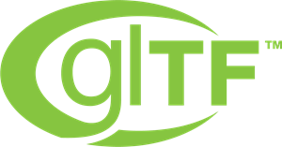

What is the answer for us
JSON is an open standard file format and data interchange format that uses human-readable text to store and transmit data objects consisting of attribute–value pairs and arrays (or other serializable values). It is a common data format with diverse uses in electronic data interchange, including that of web applications with servers
glTF™ (GL Transmission Format) is a royalty-free specification for the efficient transmission and loading of 3D scenes and models by applications. It minimizes both the size of 3D assets, and the runtime processing needed to unpack and use those assets.
glTF defines an extensible, common publishing format for 3D content tools and services that streamlines authoring workflows and enables interoperable use of content across the industry.
It is a platform-neutral, open data schema specification that is not controlled by a single vendor or group of vendors. It is an object-based data schema with a data model developed by buildingSMART to facilitate interoperability in the AEC industry.

Slide 18
Where do I start?

Slide 19
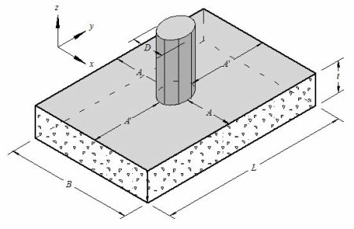
Identify base classes
Where do we start?
The first step is to identify base objects. Regardless of the authoring tools we want to use, a rectangular footing is always a rectangular footing!
Insertion point (X, Y, Z)
Width
Length
Depth

Slide 20
Identify base classes
Let’s get some code!
namespace ObjectModel
{
public class Position{
public double X { get; set; }
public double Y { get; set; }
public double Z { get; set; }
}
public class Footing{
public double Width { get; set; }
public double Length { get; set; }
public double Depth { get; set; }
public Position Position { get; set; }
}
}
Insertion point (X, Y, Z)
Width
Length
Depth
Simple classes can be referenced by other classes to create more complex object.
Same like we can use words to compose more complex words

Slide 21
Identify base classes
And my foundation is?
public Footing MyFooting = new Footing() {
Width = 1,
Length = 1,
Depth = 1,
Position = new Position(){
X = 0,
Y = 0,
Z = 0
}
};
namespace ObjectModel
{
public class Position{
public double X { get; set; }
public double Y { get; set; }
public double Z { get; set; }
}
public class Footing{
public double Width { get; set; }
public double Length { get; set; }
public double Depth { get; set; }
public Position Position { get; set; }
}
}

Slide 22
Identify base classes
Which converts to JSON…
public Footing MyFooting = new Foundation() {
Width = 1,
Length = 1,
Height = 1,
Position = new Position(){
X = 0,
Y = 0,
Z = 0
}
};
{
“myFooting": {
"width": 1,
"length": 1,
"depth": 1,
"position": {
"x": 0,
"y": 0,
"z": 0
}
}
}

Slide 23
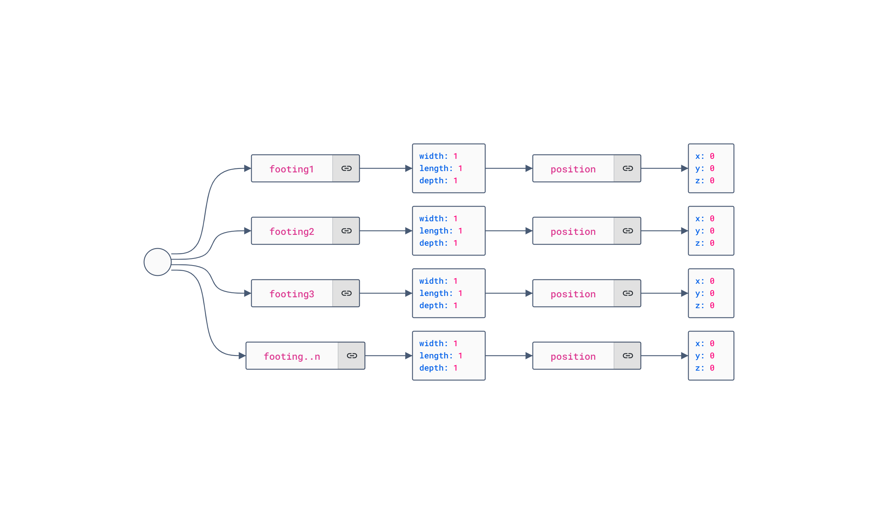
Identify base classes
JSON Editor
Which converts to JSON…

Slide 24
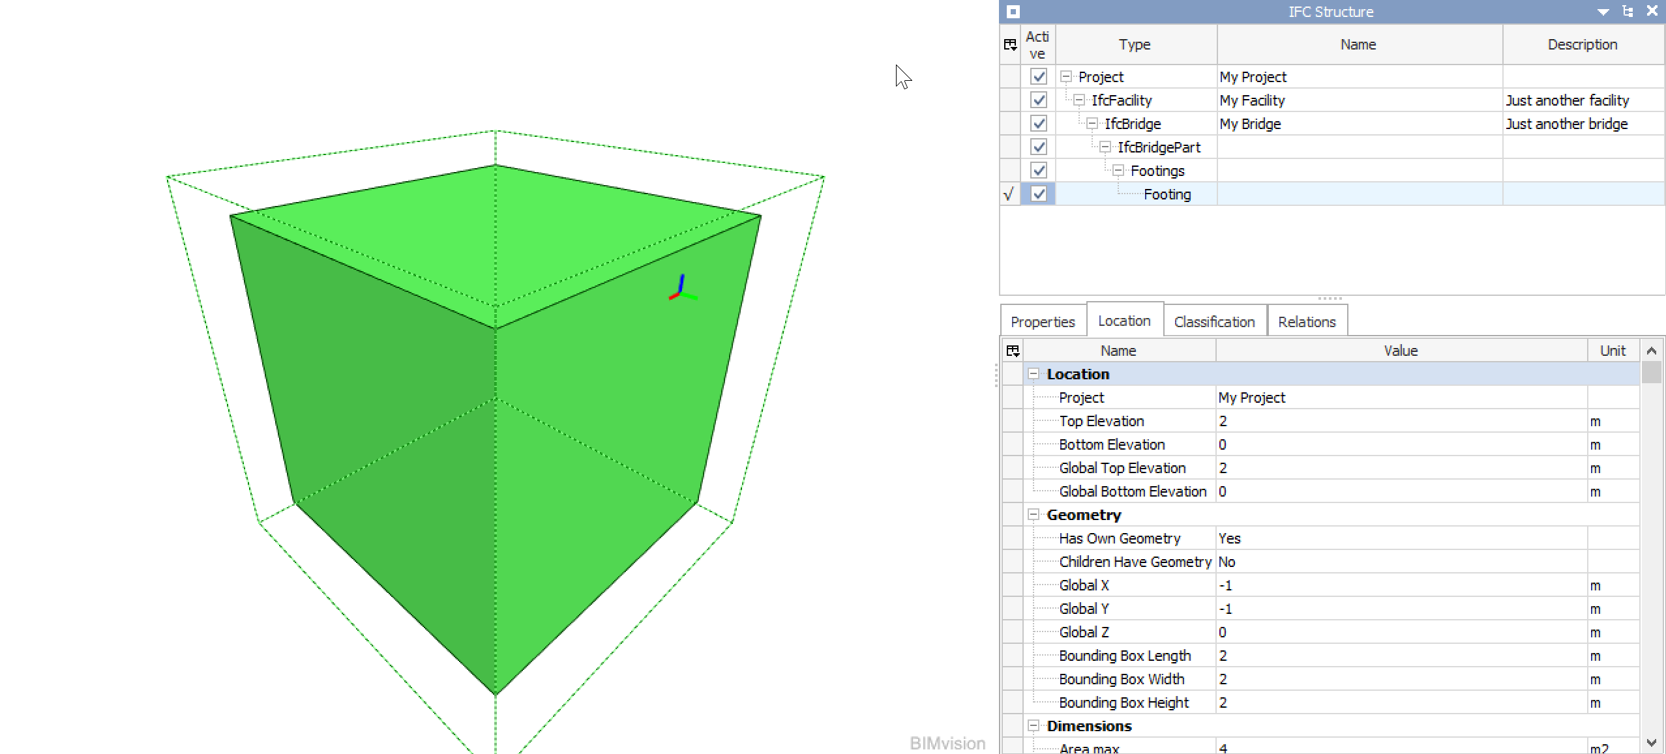
Identify base classes
ifcFooting
Which converts to IFC…

Slide 25
Now some real code…

Slide 26
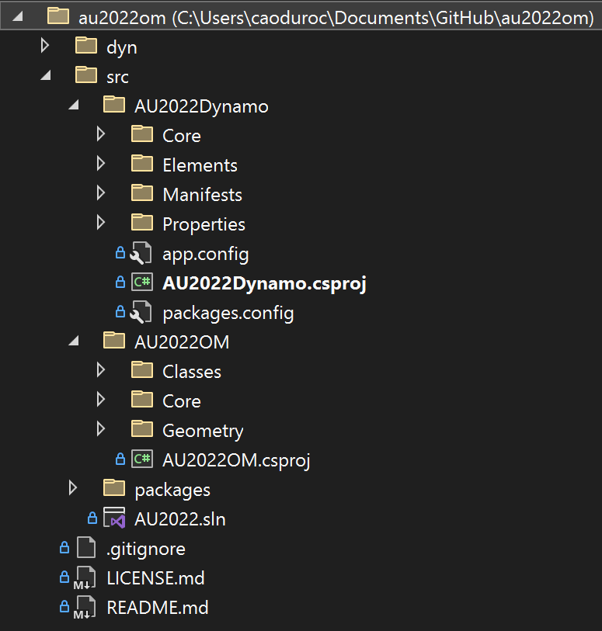
Solution structure
Visual Studio
Example files
Dynamo Package [ netframework 4.8 ]
Base class library [ netstandard 2.0 ]
.gitignore defines the files that are not required to be synchronized with the main repository

Slide 27
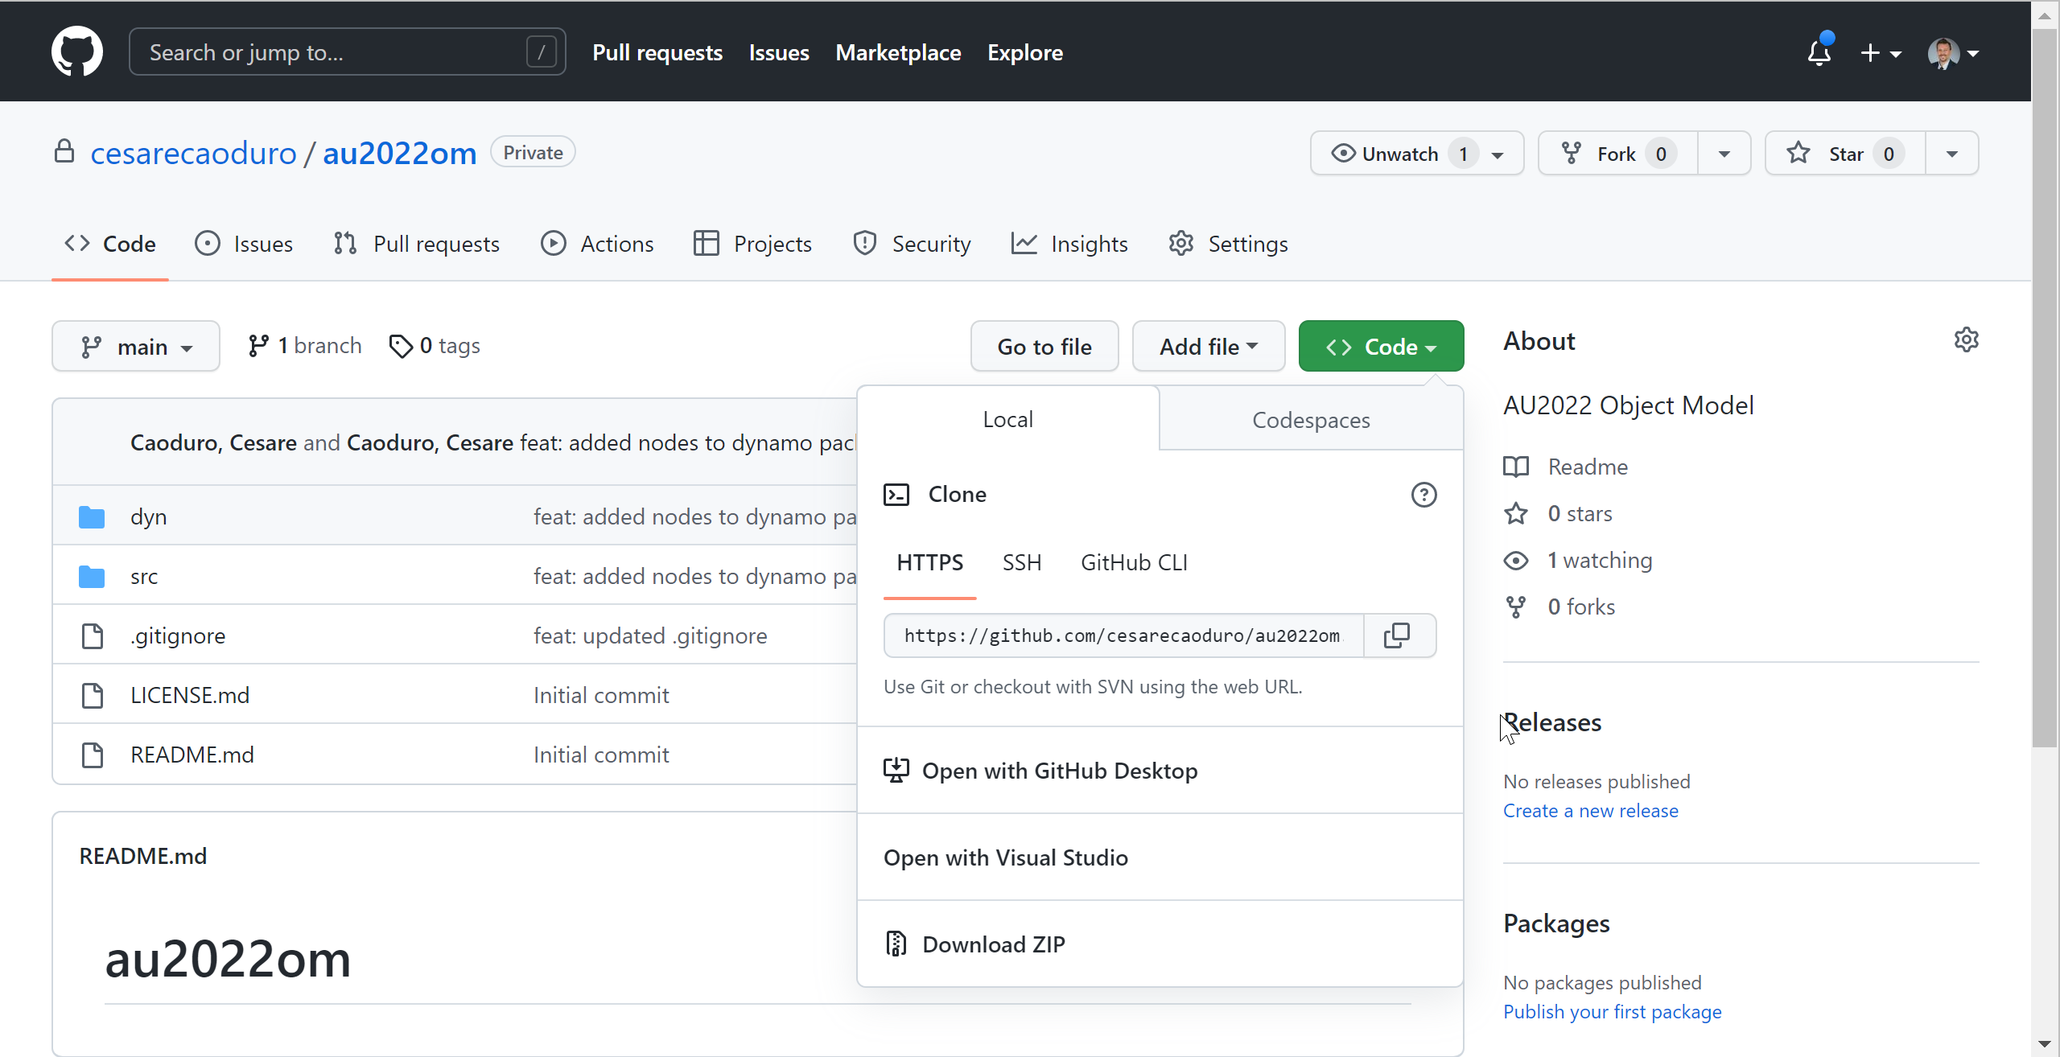
Solution structure
GitHub
Github repository

Slide 28
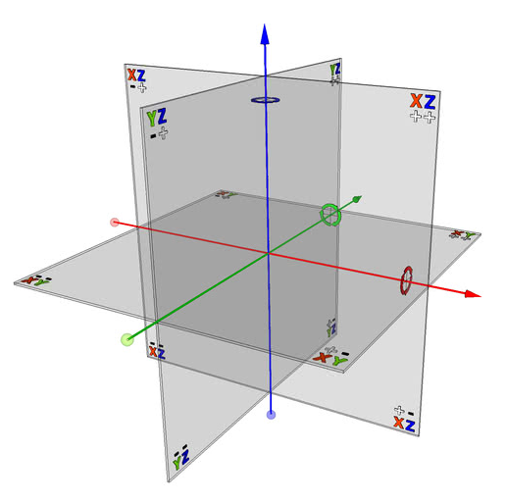
Class inheritance
Example: Point3
// ObjectBase.cs
namespace AU2022OM.Core{
public abstract class ObjectBase { }
}
// GeometryBase.cs
namespace AU2022OM.Core
{
public abstract class GeometryBase : ObjectBase { }
}
// Point3.cs
namespace AU2022OM.Geometry {
public class Point3: GeometryBase {
public double X { get; set; }
public double Y { get; set; }
public double Z { get; set; }
public Point3(double x, double y, double z) {
this.X = x;
this.Y = y;
this.Z = z;
}
}
}

Slide 29
Live demo

Slide 30
Some tips
How to automate the local deployment of Dynamo packages
There are a few lines of code that will make your life a lot easier when testing locally packages, just modifying the csproj file
<Target Name="PackageDeploy">
<ItemGroup>
<SourcePackage Include="$(PackageFolder)**\*" />
</ItemGroup>
<PropertyGroup>
<DynamoCore2_15>$(AppData)\Dynamo\Dynamo Core\$(VersionCore2_15Folder)\packages</DynamoCore2_15>
<DynamoRevit2_12>$(AppData)\Dynamo\Dynamo Revit\$(VersionRevitFolder2_12)\packages</DynamoRevit2_12>
</PropertyGroup>
<!--Copying to Package Folder-->
<Copy SourceFiles="@(SourcePackage)" Condition="Exists($(DynamoCore2_15))" DestinationFolder="$(DynamoCore2_15)\$(PackageName)\%(RecursiveDir)" />
<Copy SourceFiles="@(SourcePackage)" Condition="Exists($(DynamoRevit2_12))" DestinationFolder="$(DynamoRevit2_12)\$(PackageName)\%(RecursiveDir)" />
<Exec Command="rd /s /q $(SolutionDir)dist" />
</Target>

Slide 31
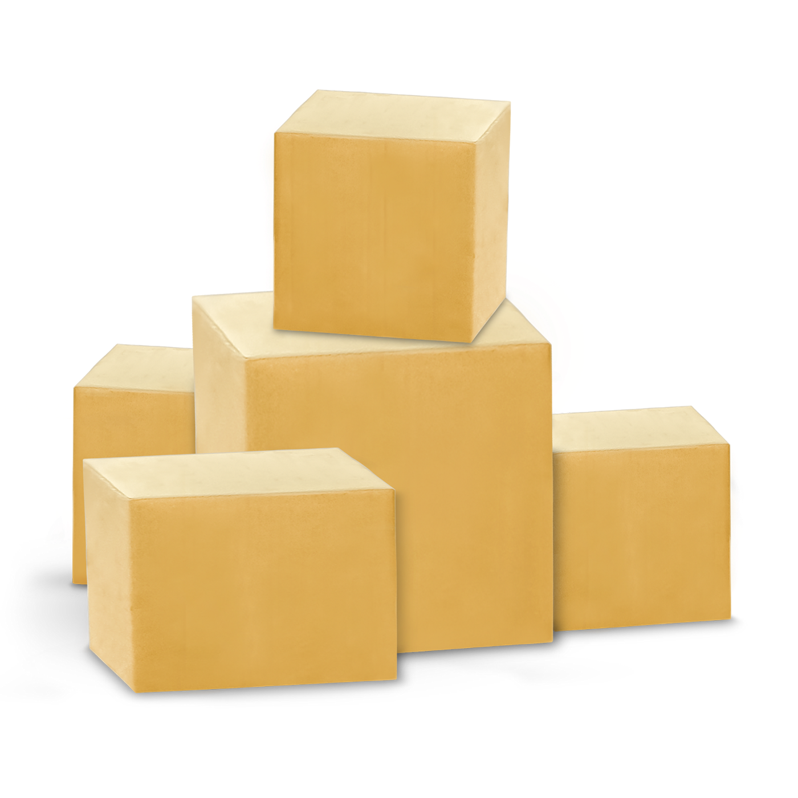
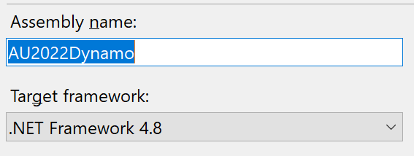
Some tips
Define a package json file
{
"license": "MIT",
"file_hash": null,
"name": "AU2022Dynamo",
"version": "1.0.0",
"description": "Dynamo Package for AU2022 presentation",
"group": "",
"keywords": null,
"dependencies": [],
"contents": "",
"engine_version": "2.13",
"engine": "dynamo",
"engine_metadata": "",
"site_url": "",
"repository_url": "",
"contains_binaries": true,
"node_libraries": [
"AU2022Dynamo, Version=1.0.0, Culture=neutral, PublicKeyToken=null"
]
}
This needs to match the name of the DLL

Slide 32
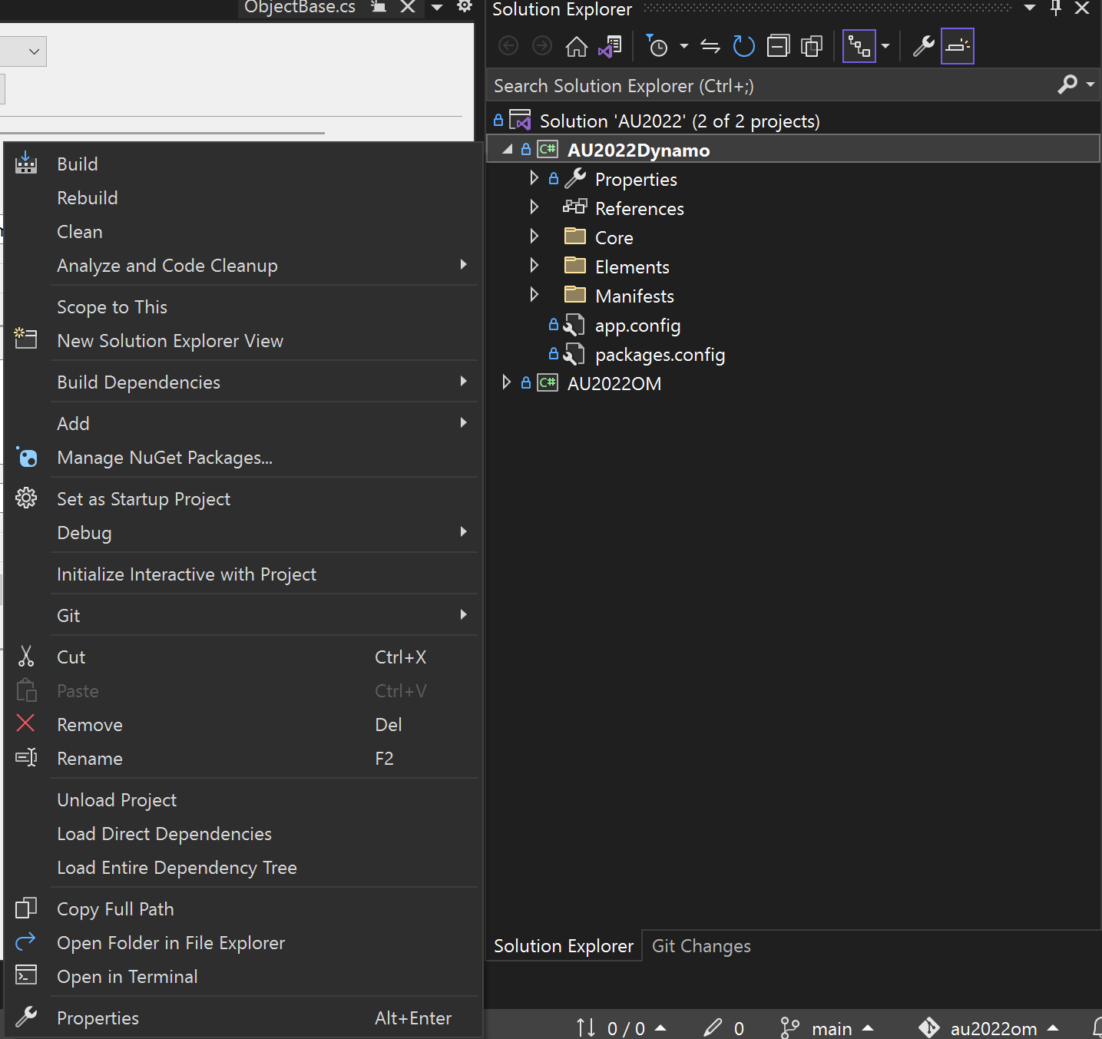
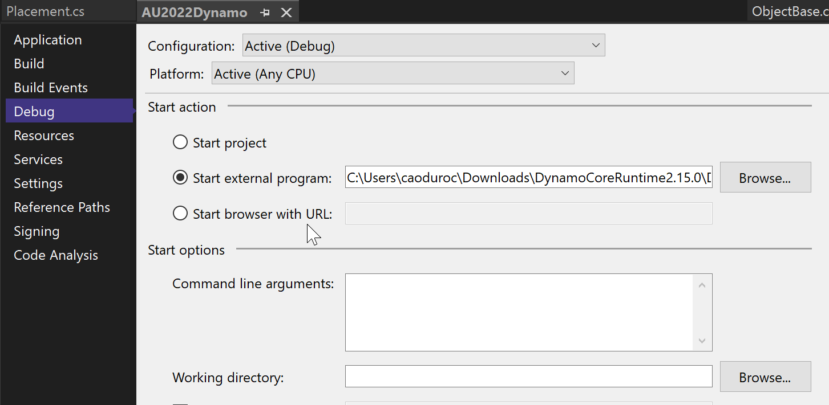
Some tips
Set your project startup…

Slide 33
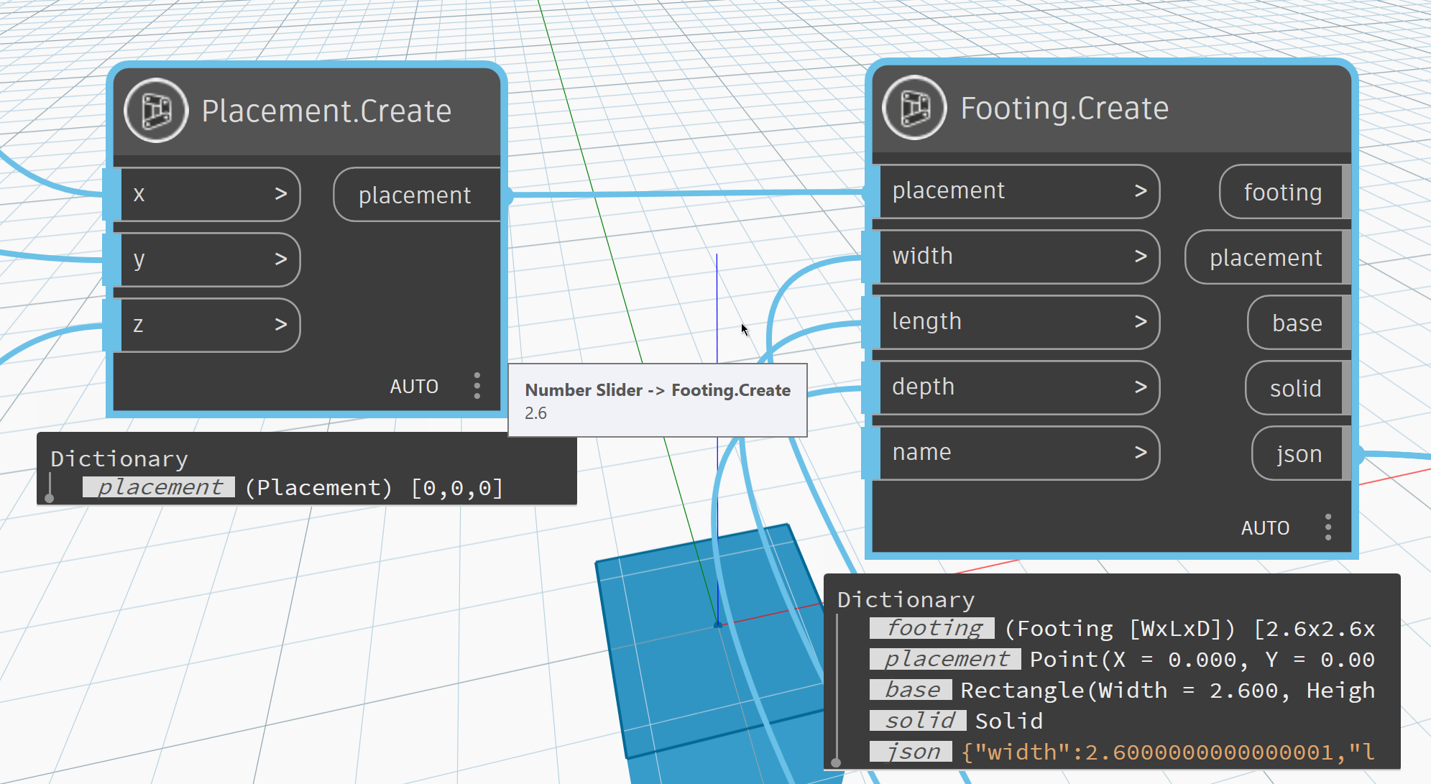
Some tips
Use words wisely
Maintain a consistent approach in assigning names to inputs and outputs.
Override the ToString() method to expose meaningful information about elements

Slide 34


Class material
Scan this QR code
All the material is hosted in a GitHub repository
Feel free to clone the repo and start playing with it and if you feel confident, make a pull request to help everyone else!
Reach out if you feel lost!
Cesare Caoduro | LinkedIn

